Slide 1
Dynamic Audio for Digital Media
Lecture 3 ~ Interaction
Dr Christos Michalakos
c.michalakos@abertay.ac.uk

Slide 2
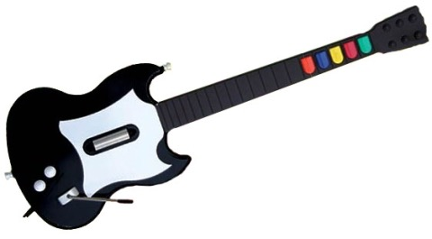
Guitar Hero Interface

Slide 3
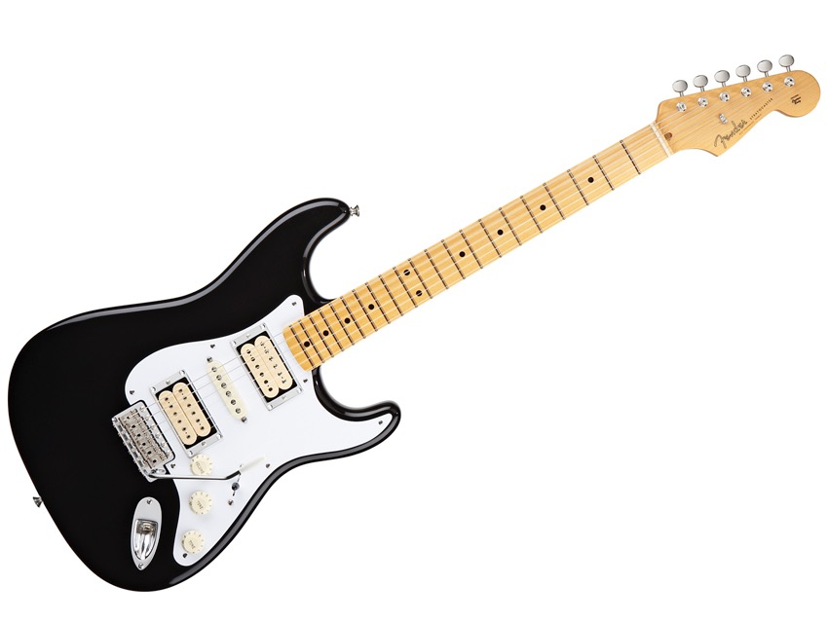
Electric Guitar Interface

Slide 4
Guitar Hero
https://www.youtube.com/watch?v=uvHYnCipiKk&nohtml5=False
Jimi Hendrix
https://youtu.be/JMyoT3kQMTg?t=4m58s
Musical Expression?

Slide 5
NIME
New Interfaces for Musical Expression
https://www.youtube.com/watch?v=JnLylwvWIpE

Slide 6
Affordance

Slide 7
Affordance
One of the most important concepts in Interaction Design

Slide 8
Affordance
Is the mapping of the potential action relationships between subject and object based on qualities of the object and capabilities of the subject

Slide 9
Types of Affordances
False
A false affordance is an apparent affordance that does not have any real function, meaning that the actor perceives nonexistent possibilities for action. A good example of a false affordance is a placebo button.

Slide 10
Types of Affordances
Hidden
A hidden affordance indicates that there are possibilities for action, but these are not perceived by the actor. For example, it is not apparent from looking at a shoe that it could be used to open a wine bottle.

Slide 11
Types of Affordances
Perceptible
For an affordance to be perceptible, there is information available such that the actor perceives and can then act upon the existing affordance.

Slide 12
Instrumental Extended Techniques
(through hidden affordances)
https://www.youtube.com/watch?v=4tmwtIcBjVs&nohtml5=False

Slide 13
Gaming Extended Techniques
(through hidden affordances)
https://youtu.be/2GPx-6ARSIw?t=1m25s

Slide 14
In the digital realm we have carefully
consider and design them ourselves,
in order for the experience to be deep!

Slide 15
In the digital realm we have carefully
consider and design them ourselves,
in order for the experience to be deep!
(the designer of the saxophone probably wasn’t thinking about circular breathing)

Slide 16
Mapping

Slide 17
Mapping
The translation layer correlating gesture to sound

Slide 18
Types of Mappings
1 to 1
1 to many (divergent)
Many to 1 (convergent)
Many to many

